Slide 1

THE CODERS
PRESENTS
WISDOM WEB
TRACK- MISCELLANEOUS
BY :
TARANPREET KAUR
JASKARAN SINGH
RATANDEEP SINGH
POOJA

Slide 2
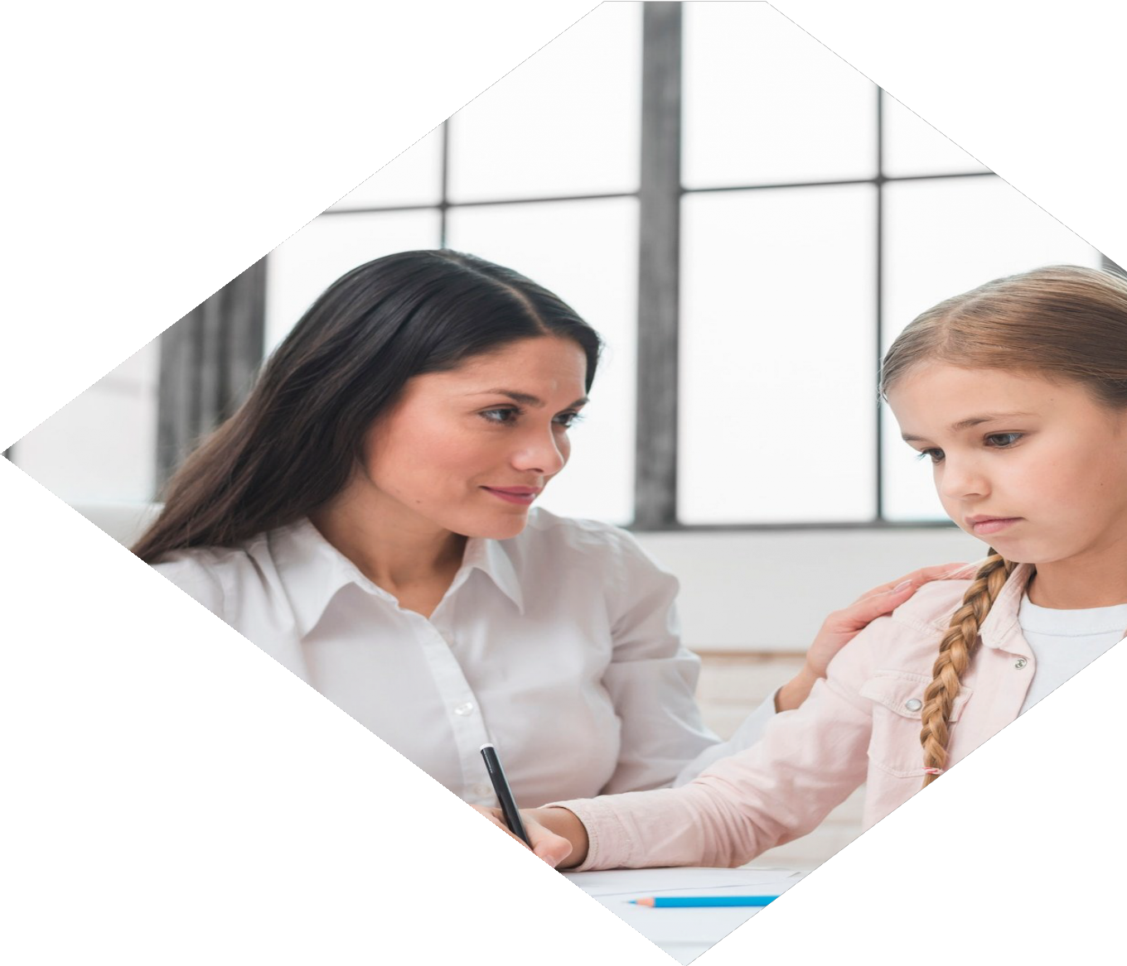
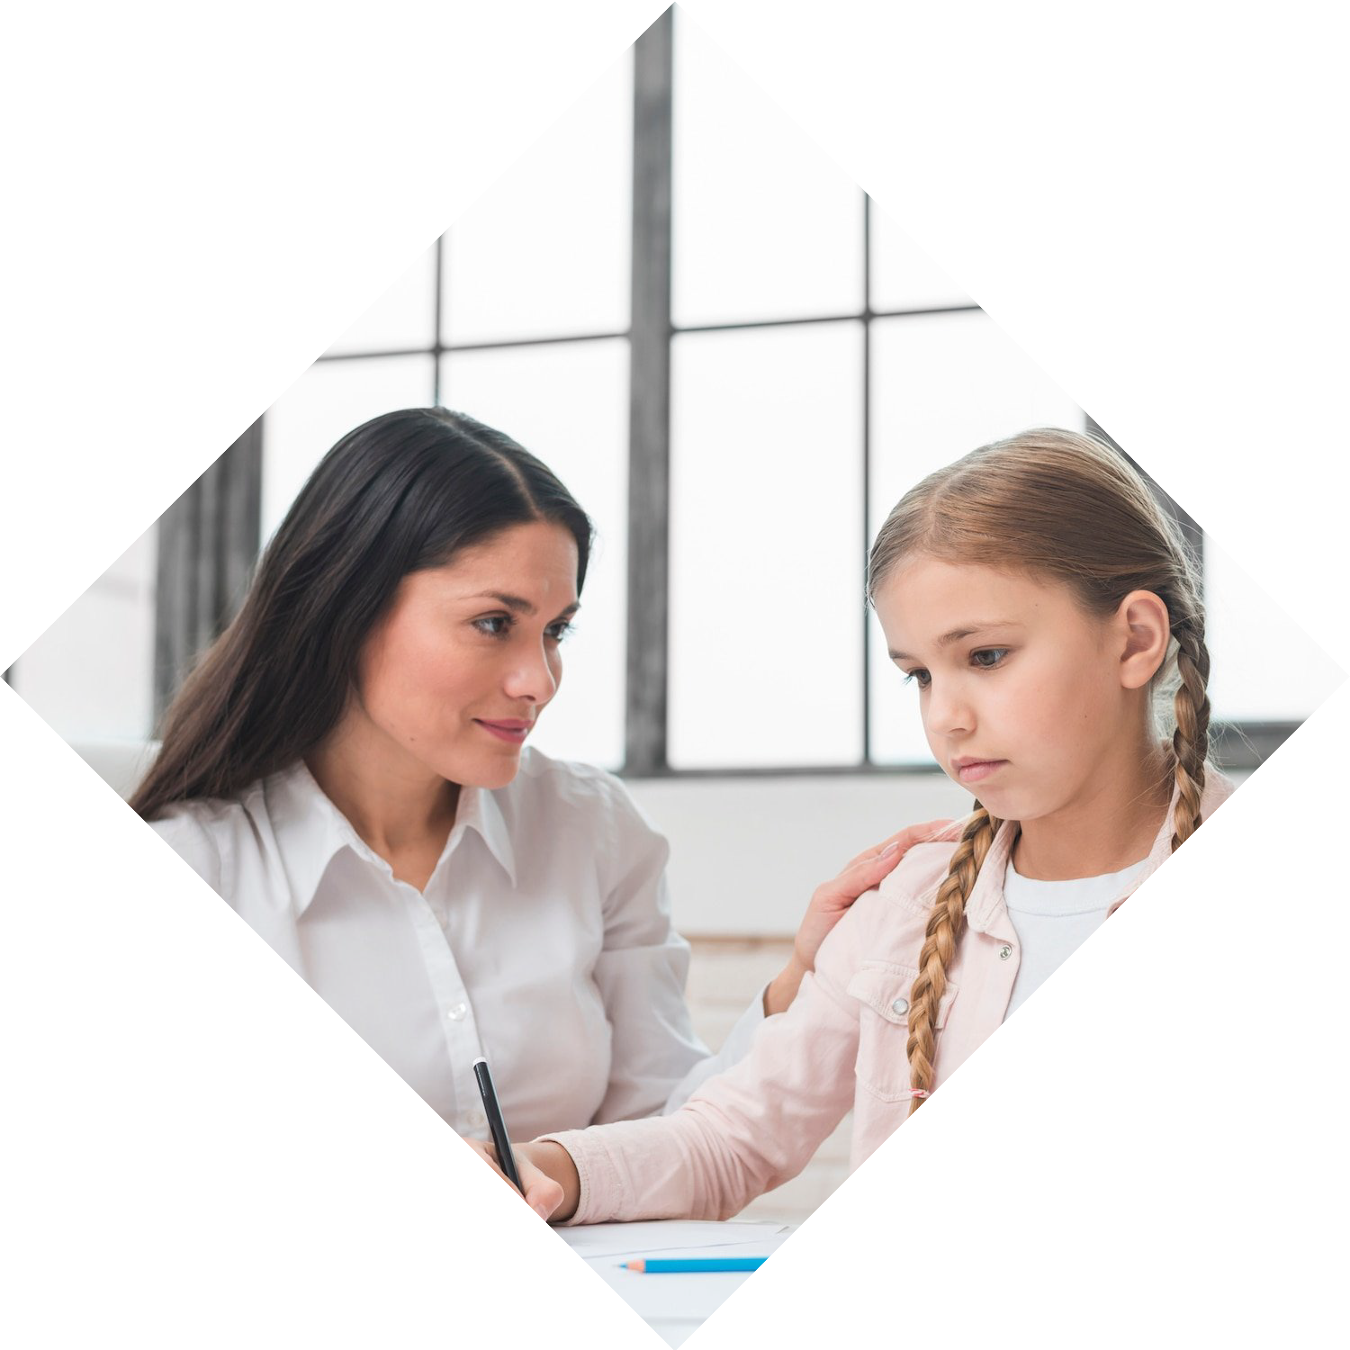
Empowering Female Students through Wisdom Web: Bridging the Gap with Teachers

Slide 3

Introduction
This presentation aims to explore how Wisdom Web can bridge the gap between female students and teachers. It will showcase how this platform can empower young women by providing access to resources, mentorship, and networking opportunities. By the end of the presentation, you will understand the importance of creating a supportive environment for female students to thrive.

Slide 4

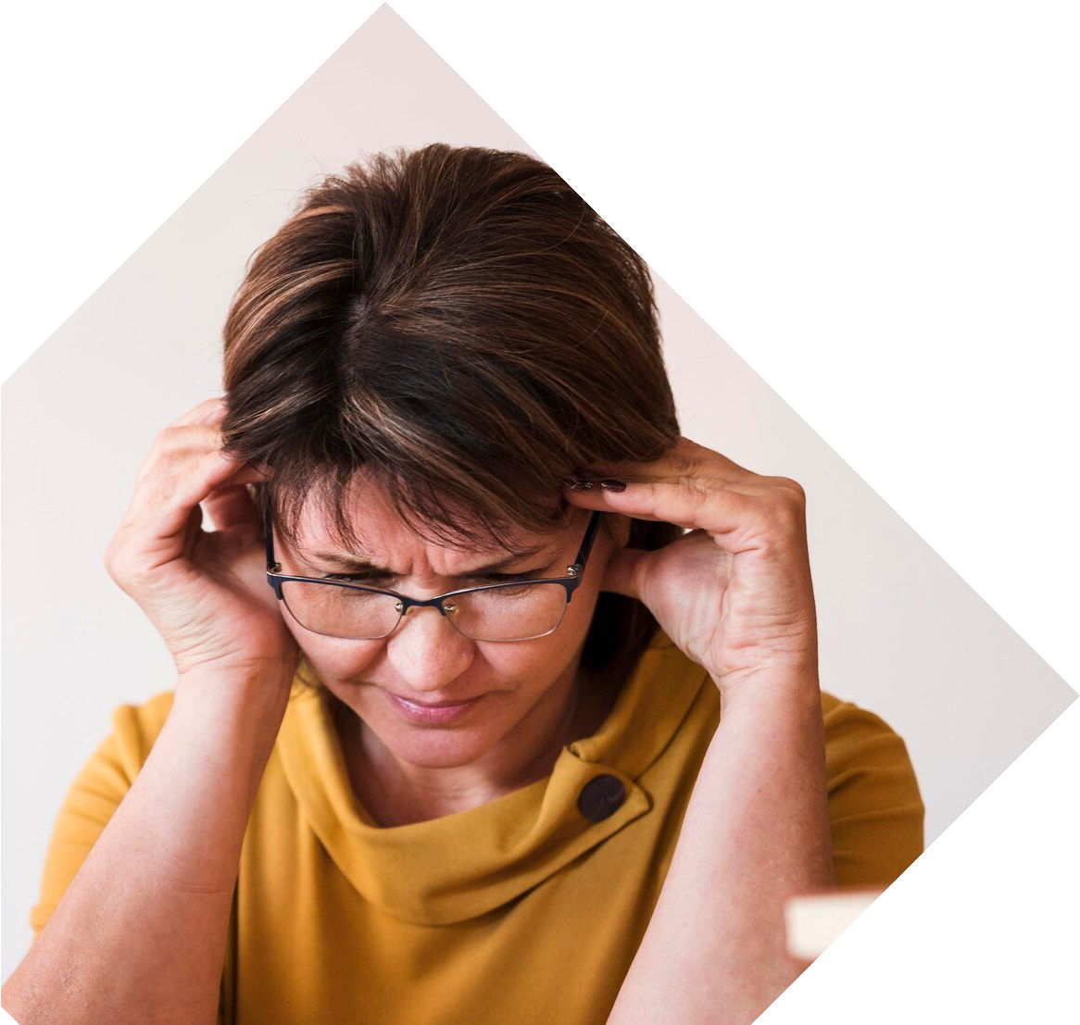
The Gender Gap in Education
Despite progress in recent years, there is still a signiﬁcant gender gap in education. Female students often face barriers such as lack of access to resources, gender bias, and discrimination. This can lead to lower academic performance and limited career opportunities.
It is crucial to address these issues and provide female students with the support they need to
succeed.

Slide 5

What is Wisdom Web?
Wisdom Web is an online platform that connects female students with mentors, resources, and networking opportunities. It provides a supportive community where young women can learn and grow. Through Wisdom Web, students can access a range of resources such as academic support, career guidance, and
leadership development.

Slide 6

The Benefits of Wisdom Web
Wisdom Web offers several beneﬁts to female students. It provides access to a network of mentors who can offer guidance and support. It also offers resources such as study materials, career advice, and leadership training.
Additionally, it provides a platform for students to connect with each other
and build a supportive community.

Slide 7

How Wisdom Web Works
To use Wisdom Web, students must create an account and complete a proﬁle. They can then access a range of resources and connect with mentors and other students.
Through these events, students can learn new skills and connect with professionals
in their ﬁeld.

Slide 8
Offers for the Female Students
We Will Provide two types of offers specially for female students:
For those who are under 14 years we will be providing free lectures to them on home science.
For those who are above 14 and under 18 we will be provid one free technical course.

Slide 9
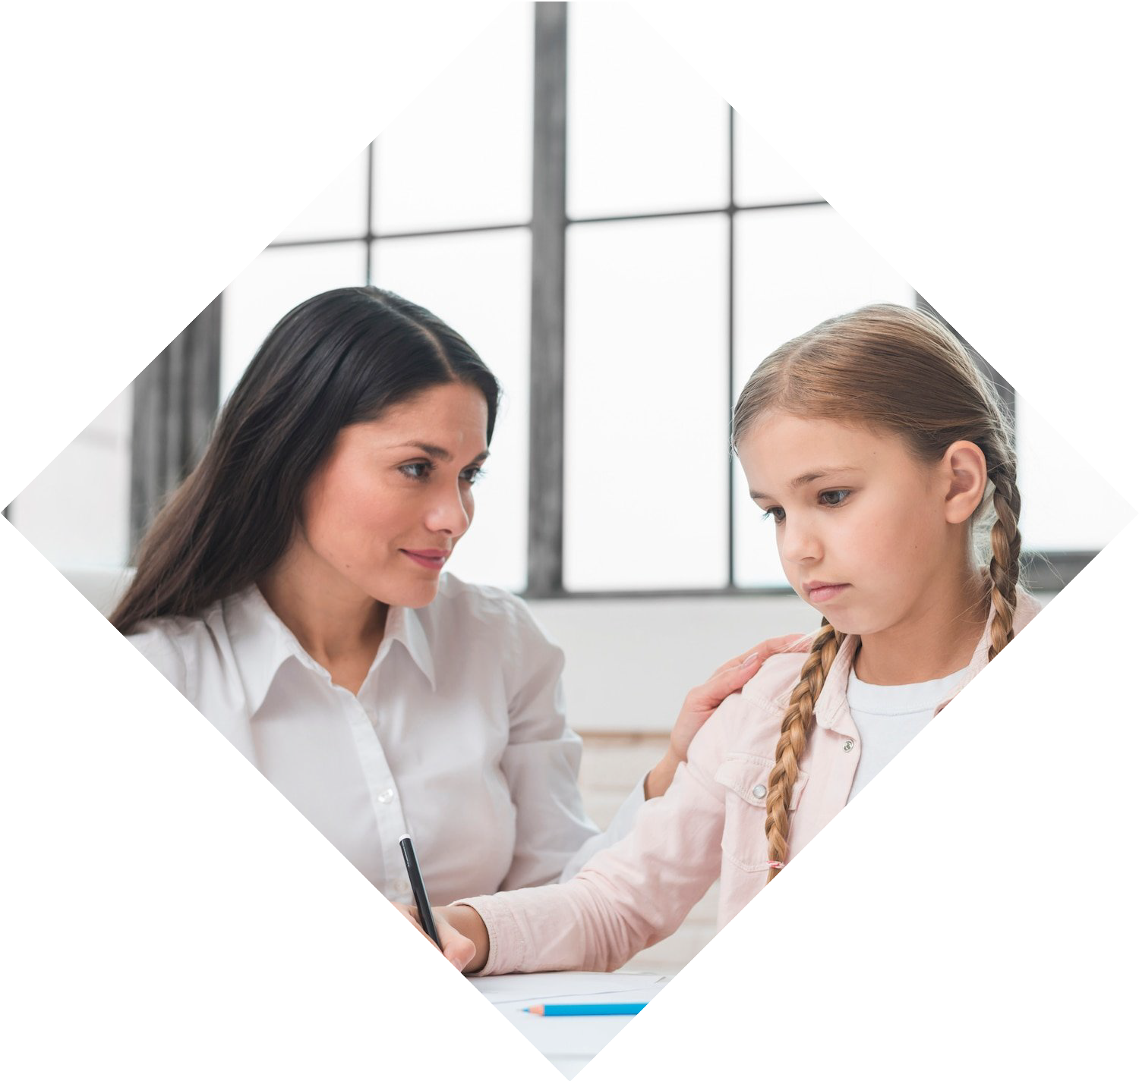
The Role of Teachers
Teachers play a crucial role in supporting female students. They can provide mentorship, guidance, and academic support. Teachers can also help create a supportive classroom environment that encourages female students to succeed. By working together with Wisdom Web, teachers can help bridge the gap and empower their students.

Slide 10

The Importance of Mentorship
Mentorship is a key component of Wisdom Web. Through mentorship, students can receive guidance and support from professionals in their ﬁeld. This can help them gain valuable insights and develop their skills. Mentorship can also provide female students with role models and help them build conﬁdence.

Slide 11

Building a Supportive Community
Wisdom Web offers a platform for female students to connect with each other and build a supportive community. This can help students feel less isolated and more connected to their peers.
Through this community, students can share experiences, offer support, and build lasting relationships.

Slide 12

Addressing Gender Bias
Gender bias is a signiﬁcant barrier for female students. It can lead to lower academic performance, limited career opportunities, and a lack of conﬁdence. By addressing gender bias in the classroom and providing support to female students, we can help them overcome these barriers and succeed.

Slide 13

Creating a Supportive Classroom Environment
Creating a supportive classroom environment is essential for empowering female students. This includes addressing gender bias, providing mentorship and support, and offering resources such as study materials and leadership training.
By creating a supportive environment, teachers can help female students thrive.

Slide 14

Empowering Female Students
Empowering female students is crucial for creating a more equitable and just society. By providing support, mentorship, and resources, we can help female students overcome barriers and achieve their goals. Wisdom Web offers a platform for female students to connect with mentors, resources, and each other.
By working together, we can bridge the gap and empower female students.

Slide 15

The Future of Education
The future of education depends on our ability to empower female students. By providing support and resources, we can help female students achieve their full potential. This will lead to a more diverse and inclusive workforce and a more equitable society. The future is bright for female students, and Wisdom Web can help them achieve their goals.

Slide 16


Online Learning
Online learning has become increasingly popular in recent years. It offers ﬂexibility and convenience for students who may have other commitments such as work or family. Wisdom Web offers online resources and events such as webinars and workshops. This can help female students access education and resources from anywhere in the world.

Slide 17

The Importance of Leadership
Leadership is a key skill for success in any ﬁeld. Wisdom Web offers resources and training in leadership development. This can help female students develop the skills they need to succeed in their careers. Leadership training can also provide female students with the conﬁdence and skills they need to become leaders in their communities.

Slide 18

Overcoming Barriers
Female students face many barriers in education and the workforce. These include gender bias, discrimination, and lack of access to resources. By working together with platforms such as Wisdom Web, we can help female students overcome these barriers and achieve their goals. Together, we can create a more equitable and just society.

Slide 19
Conclusion
In conclusion, empowering female students is crucial for creating a more equitable and just society.
Wisdom Web offers a platform for female students to connect with mentors, resources, and each other. By working together, we can bridge the gap and empower female students to achieve their goals.

Slide 20
Thanks!

